Slide 1
Review Chapter4:
Gates and Circuits

Slide 2
Key points
NOT/AND/OR/XOR/NAND Gates (their diagrams, and truth tables)
Gates and Circuits
Combinational circuit
Sequential circuit
Integrated Circuits and CPU Chips (concepts)

Slide 3
Terminology
Gate
Each performs one logical function
One or more input signals→ a single output signals
Methods to describe the behavior of gates
Boolean expression
Logic diagrams
Truth tables
Equally powerful

Slide 4
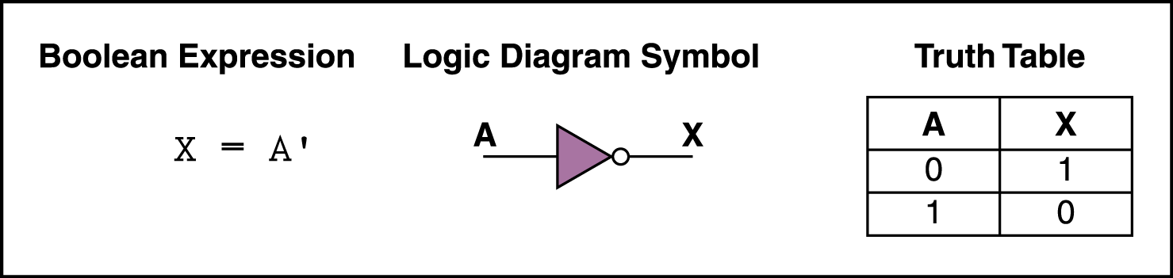
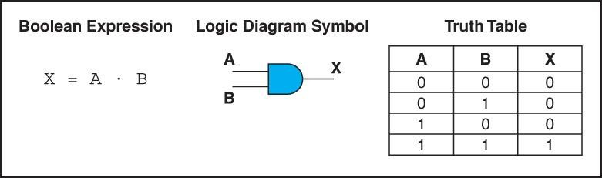
Gates-NOT&AND
NOT
AND

Slide 5
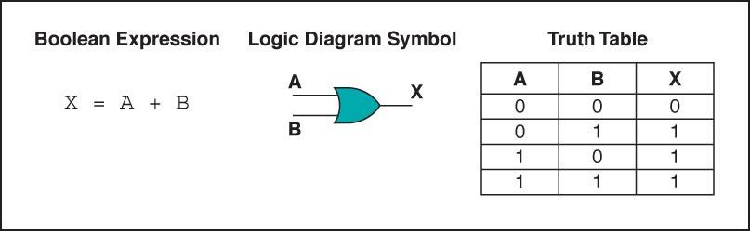
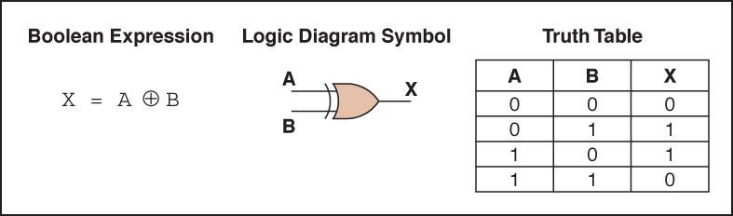
Gates-XOR&OR
OR
XOR

Slide 6
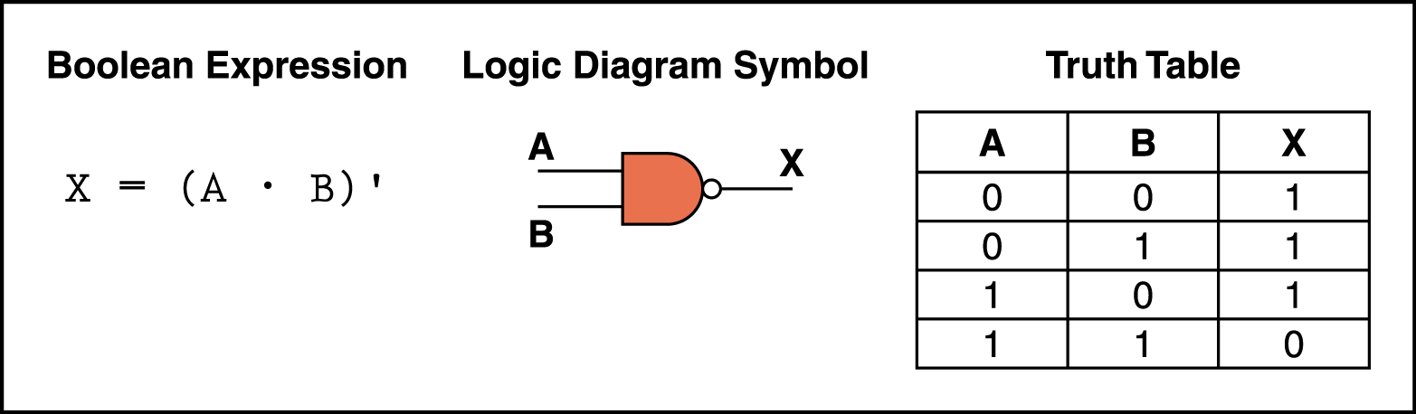
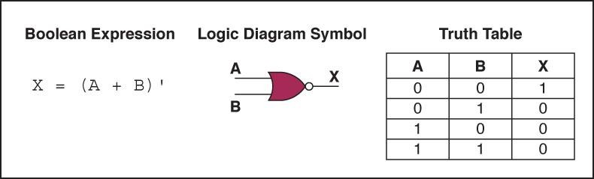
Gates-NAND&NOR
NAND
NOR

Slide 7
4.4 Circuits-Categories
Combination circuit
A circuit whose output is solely determined by its input values
Sequential circuit
A circuit whose output is a function of its input values and the current state of the circuit
To store information

Slide 8
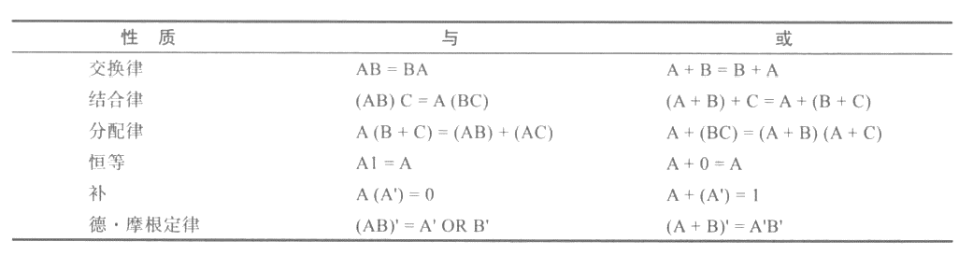
4.4 Circuits-Circuit equivalence
Both circuits produce exactly the same output for each input value combination

Slide 9
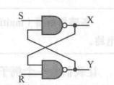
4.5 Circuits as Memory
Sequential circuit
Can store information
The output of the circuit also serves as input to the circuit
A circuit whose output is a function of its input values and the current state of the circuit

Slide 10

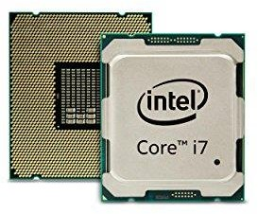
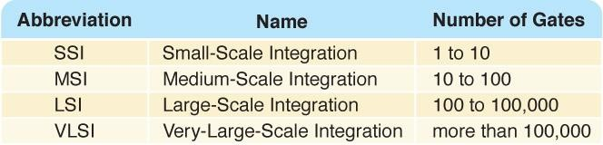
4.6 Integrated Circuits (IC)
CPU chips

Slide 11
Key Terms
Transistor
作为导线或电阻器的设备，由输入信号的电平决定它的作用
Gate/Circuit
门：对电信号执行基本运算的设备，接受一个或者多个输入信号，生成一个输出信号
电路：相互关联的门的组合，用于实现特定的逻辑函数
Integrated circuit(chip)
嵌入了多个门的硅片
Combinational circuit
输出值仅由输入值决定的电路
Sequential circuit
输出是由输入值和电路当前状态的函数的电路
Boolean algebra表示二值逻辑函数的数学表示法
Logic diagram
电路的图形化表示，每种电路都有自己专用的符号
Boolean expression
评价为真或者假的表达式
Truth table列出了所有可能的输入值和相关的输出值的表

